Slide 1
Bureau of Meteorology Update
NAEDEX-26 / APSDEU-14

Slide 2
Overview
Himawari-8
COSMIC-2
New supercomputer
Status of data assimilation
Data impacts work
Quantitative satellite products
WIS and OpenWIS
Observing network - latest news

Slide 3
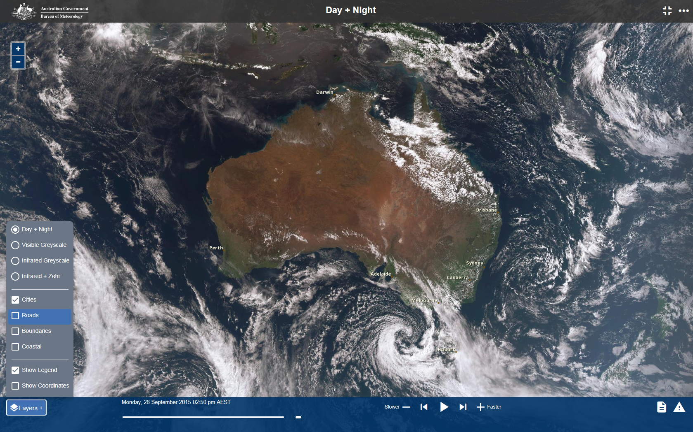
Himawari-8
• Himawari-8 began operation on 7 July 2015
Single channel images and derived products support forecasting activities
10 minute AMVs will be assimilated
Training resources at http://www.virtuallab.bom.gov.au/
Data from the satellite became available from a new viewer on the Bureau’s website on 30 September 2015

Slide 4
COSMIC-2
• The Bureau will become a partner in the COSMIC-2 program in 2016, when it hosts a COSMIC-2 ground station near Darwin.
A ground station near the Equator is seen by NOAA as playing a very valuable role in overall ground architecture, significantly improving data timeliness, and Darwin was identified as a good location both for COSMIC-2/FORMOSAT-7 ground data reception, and also for back-up spacecraft command

Slide 5
New Supercomputer "Australis"
• The Bureau’s replacement supercomputer is scheduled to become operational from July 2016.
• Cray XC40, 1660 teraflop (Phase 1), eventually 5 petaflops (Phase 2) with 12 petabytes of storage
16 times faster than the existing 104 teraflop system
The new system will allow the Bureau to run eight times as many daily forecasts and deliver a five times improvement in global model resolution

Slide 6
Forecast Models | Current Capability | Target End-2015 (APS2) | Target Mid-2018 (APS3) | Target End-2020 (APS4)
Global weather (deterministic) | 40km spatial, 70 vert levels 2 x 10-day fc 2 x 3-day fc | 25km spatial, 70 vert levels 2 x 10-day fc 2 x 3-day fc | 12km spatial, 85 vert levels 2 x 10-day fc 2 x 3-day fc | 12km spatial, 110 vert levels 2 x 10-day fc 2 x 3-day fc
Regional weather (deterministic) | 12km spatial, 70 vert levels 4 x 3-day fc | 12km spatial, 70 vert levels 4 x 3-day fc | 8km spatial, 85 vert levels 4 x 3-day fc | 4.5km spatial, 110 vert levels 4 x 3-day fc
City/State weather (deterministic) | 4km spatial, 70 vert levels 4 x 36-hour fc | 1.5km spatial, 70 vert levels 4 x 36-hour fc | 1.5km spatial, 85 vert levels 4 x 36-hour fc 4 x 18-hour fc 16 x 9-hour fc | 1.5km spatial, 110 vert levels 4 x 36-hour fc 4 x 18-hour fc 16 x 9-hour fc
Global weather (ensemble) | N/A | 60km spatial, 70 vert levels 24 members 2 x 10-day fc | 30km spatial, 85 vert levels 24 members 2 x 10-day fc | 30km spatial, 110 vert levels 32 members 2 x 10-day fc
City/State weather (ensemble) |  | N/A | 2.2km spatial 85 vert levels 6 members 4 x 24-hour fc 4 x 36-hour fc | 1.5km spatial 110 vert levels 6 members 4 x 24-hour fc 4 x 36-hour fc
On demand deterministic: APS3-City
On demand ensemble: APS4-City
APS3-TC: similar to APS4-R

Slide 7
Data assimilation: future plans
Himawari-8 AMVs to be operationally assimilated
SSM/IS will be operationally assimilated
NOAA VIIRS required for ocean colour
Global SMOS SSS required for ocean model
Sentinel-3 SSTs
HY-2A/B
TERRASAR-X to be assimilated (COSMIC, METOP and GRACE already assimilated)
Ground based GPS derived ZTD
Wind profiler data

Slide 8
Data impacts activities
Forecast Sensitivity to Observations (FSO) Project
Leveraging off previous MetOffice work in this area
Outcome: global and regional ACCESS FSO suites, running in real time
Analysis and visualisation tools to produce information for network managers
Will provide supporting evidence for new investments in observations infrastructure

Slide 9
Quantitative satellite products
Himawari-8 products are being developed:
Sixteen single channel products
RGB products based on algorithms from EUMETSAT's SEVIRI imager (atmospheric air mass, microphysical properties, severe storm identification, dust)
Fog/low cloud, volcanic ash, solar radiation, SST, cloud properties

Slide 10
WIS implementation
WIS Implementation History
2006 – 2008 : Participating SIMDAT.
2007: Establishing WIS Project Manager position.
2008: Commitment to become GISC.
2010: Joining OpenWIS Consortium.
2011: WMO WIS JumpStart.
Approval of WIS (OpenWIS) Implementation Project.
2012:
January: OpenWIS installation workshop
May: OpenWIS installation/integration
June: Passed GISC audit
Late June: Fully designation as GISC by EC of WMO
2013:
March: Trial by RA-V countries and major GISCs
April: GISC Melbourne go live.
2015: Registered the OpenWIS Association in Brussels

Slide 11
OpenWIS development
OpenWIS:
Developed in collaboration between Meteo France, UK MetOffice, Bureau of Meteorology, Korea Meteorological Administration, Meteo France International
Agencies have formed the OpenWIS Assciation to own the software and IP
Open source software

Slide 12
OpenWIS Operational Installation in the Bureau
OpenWIS
PORTAL
ADMINISTRATION
Access / Follow Requests
Discover Browse Catalogue
Admin & Monitoring
Adminis-tration
Monitoring
METADATA SERVICE
SECURITY SERVICE
DATA SERVICE
Synchro-nization
Harvesting
Authori-zation
Collection
Replication
meta
data
global
data
Catalogue Access
DAR
Catalogue
Authenti-cation
User
Store
24 hour
Cache
Request Processing
WIS Harnesses
Internal System
Disse-
mination
(AIFS)
Data
Sources
(RTDB, ADAM)
CMSS
global data
outbound to users

Slide 13
Observing network
High frequency BUFR sonde data now available to forecasters
Bureau wind profiler data from 11 profilers will be QC'd in real time by E-PROFILER at the UK MetOffice and then put on GTS. Imminent.
ADSB mode–S derived data was compared with AMDAR and sondes. Temperature and wind data performed well. ADSB mode–S would provide significantly more data than AMDAR (2 million vs 6800 per day).
Bureau collaboration with Geoscience Australia on GPS derived water vapour is ongoing.

Slide 14
Thank you…
Anthony Rea
a.rea@bom.gov.au

